Slide 1



Agentic AI: Transforming Government Service Delivery
From Instruction Manual to Autonomous Partner
Dr. Ernesto Lee
Dr. Pedro Santos Acosta
Miami Dade College
Presented to Miami Dade County Government
Notes:
"You ask ChatGPT: 'How do I process a permit application for a new restaurant?' It gives you a perfect 12-step answer. Step 1: Check zoning compliance. Step 2: Verify fire safety requirements. Step 3: Schedule health department inspection. And so on. Great information, but now you have to actually do all twelve steps yourself, switching between different systems, making phone calls, sending emails, waiting for responses.
You spend the next four hours doing exactly what ChatGPT told you to do. The AI gave you the knowledge, but YOU did all the work. YOU made the calls. YOU filled out the forms. YOU coordinated between departments. The AI was basically an extremely smart instruction manual.
But here's a mind-bending question: What if that same AI could actually make those phone calls for you? What if it could fill out those forms, coordinate with different departments, and move that permit application through the entire approval process while you focused on more complex cases that require human judgment?
This isn't science fiction. It's happening right now, and it's called Agentic AI. The difference between regular AI and Agentic AI will transform how government works."

Slide 2


AI Evolution: From Advisor to Autonomous Agent
Traditional AI tells you what to do; Agentic AI does it for you
Core Benefits:
Speed:
Process tasks in minutes vs. weeks
Consistency:
Uniform application of rules and procedures
Scale:
Handle multiple workflows simultaneously
Bottom Line:
Transform citizen service delivery through autonomous AI agents that bridge the execution gap
Notes:
"To understand why Agentic AI is revolutionary, we need to see how human-computer interaction has evolved. For decades, computers could only do exactly what you programmed them to do, step by step. You had to anticipate every possible scenario and code specific responses.
Even today, most government work involves this same pattern. You receive a citizen request, look up the relevant regulations, check multiple databases, coordinate with other departments, and manually process everything through various systems. The computer helps with storage and calculation, but YOU orchestrate the entire workflow.
When ChatGPT arrived, it seemed revolutionary because you could ask complex questions in plain English and get intelligent answers. But fundamentally, nothing changed about WHO was doing the work. The AI became an incredibly sophisticated consultant, but you were still the executive assistant carrying out all its recommendations.
This created what we call the 'execution gap.' AI could tell you exactly how to resolve a citizen complaint, process a business license, or coordinate an emergency response. But translating that knowledge into action still required human hands on keyboards, human voices on phone calls, and human judgment at every decision point."

Slide 3

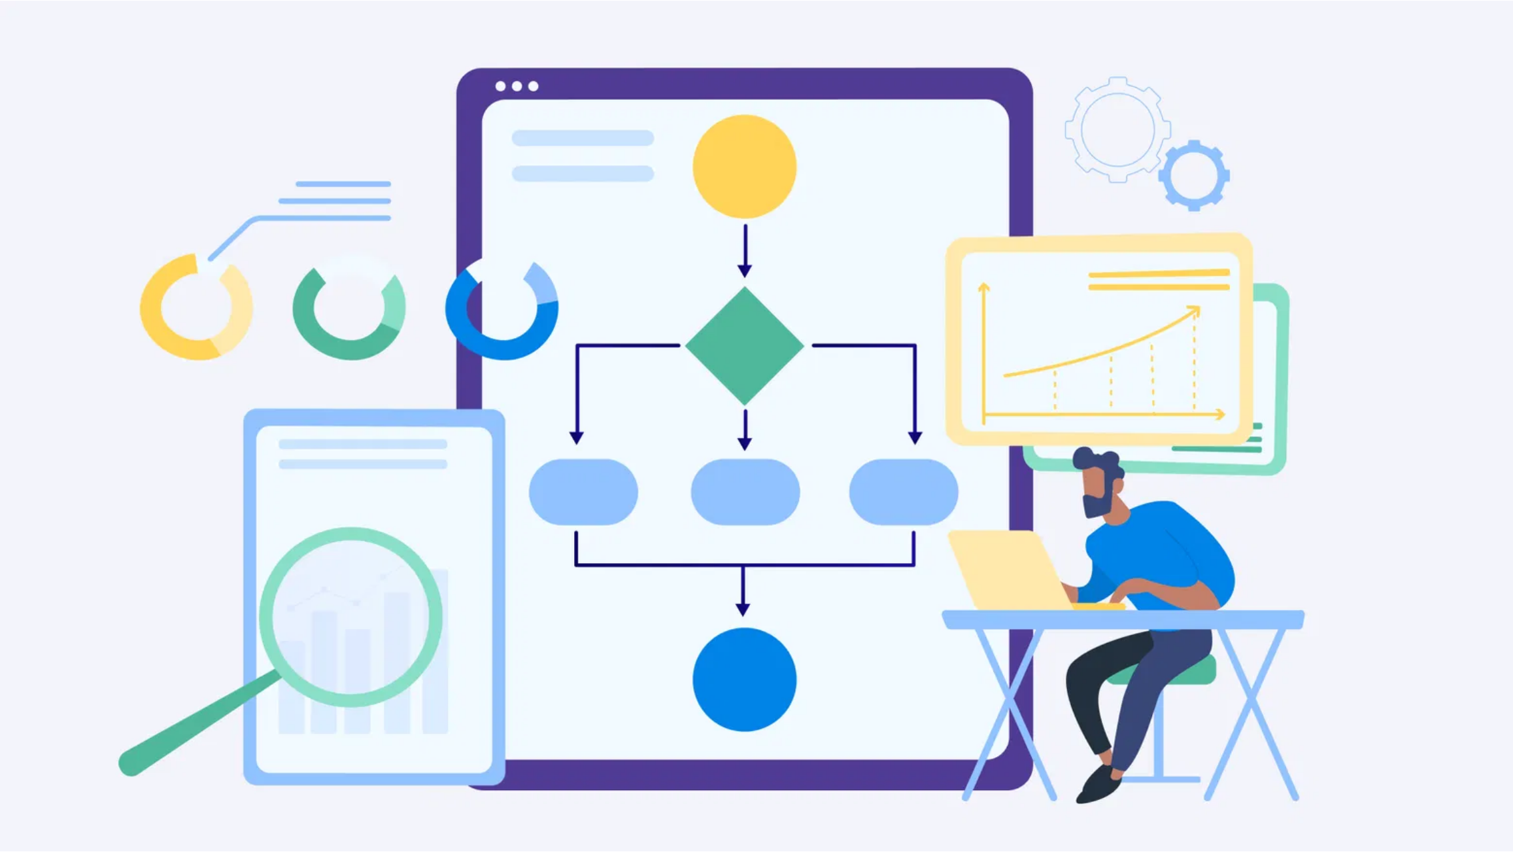
Government Efficiency Limited by Human Bandwidth
AI provides knowledge, but humans still execute all actions
Current State Challenges:
Manual Coordination:
Staff must navigate multiple systems
Execution Gap:
Knowledge without action capability
Resource Constraints:
Limited by available staff hours
Inconsistent Service:
Varies by office and staff member
Notes:
"But what if we could give AI the ability to bridge that execution gap? What if instead of just answering questions, AI could take actions in the digital systems where most government work actually happens? This insight—giving AI agency rather than just intelligence—creates possibilities that would have seemed impossible just two years ago."

Slide 4

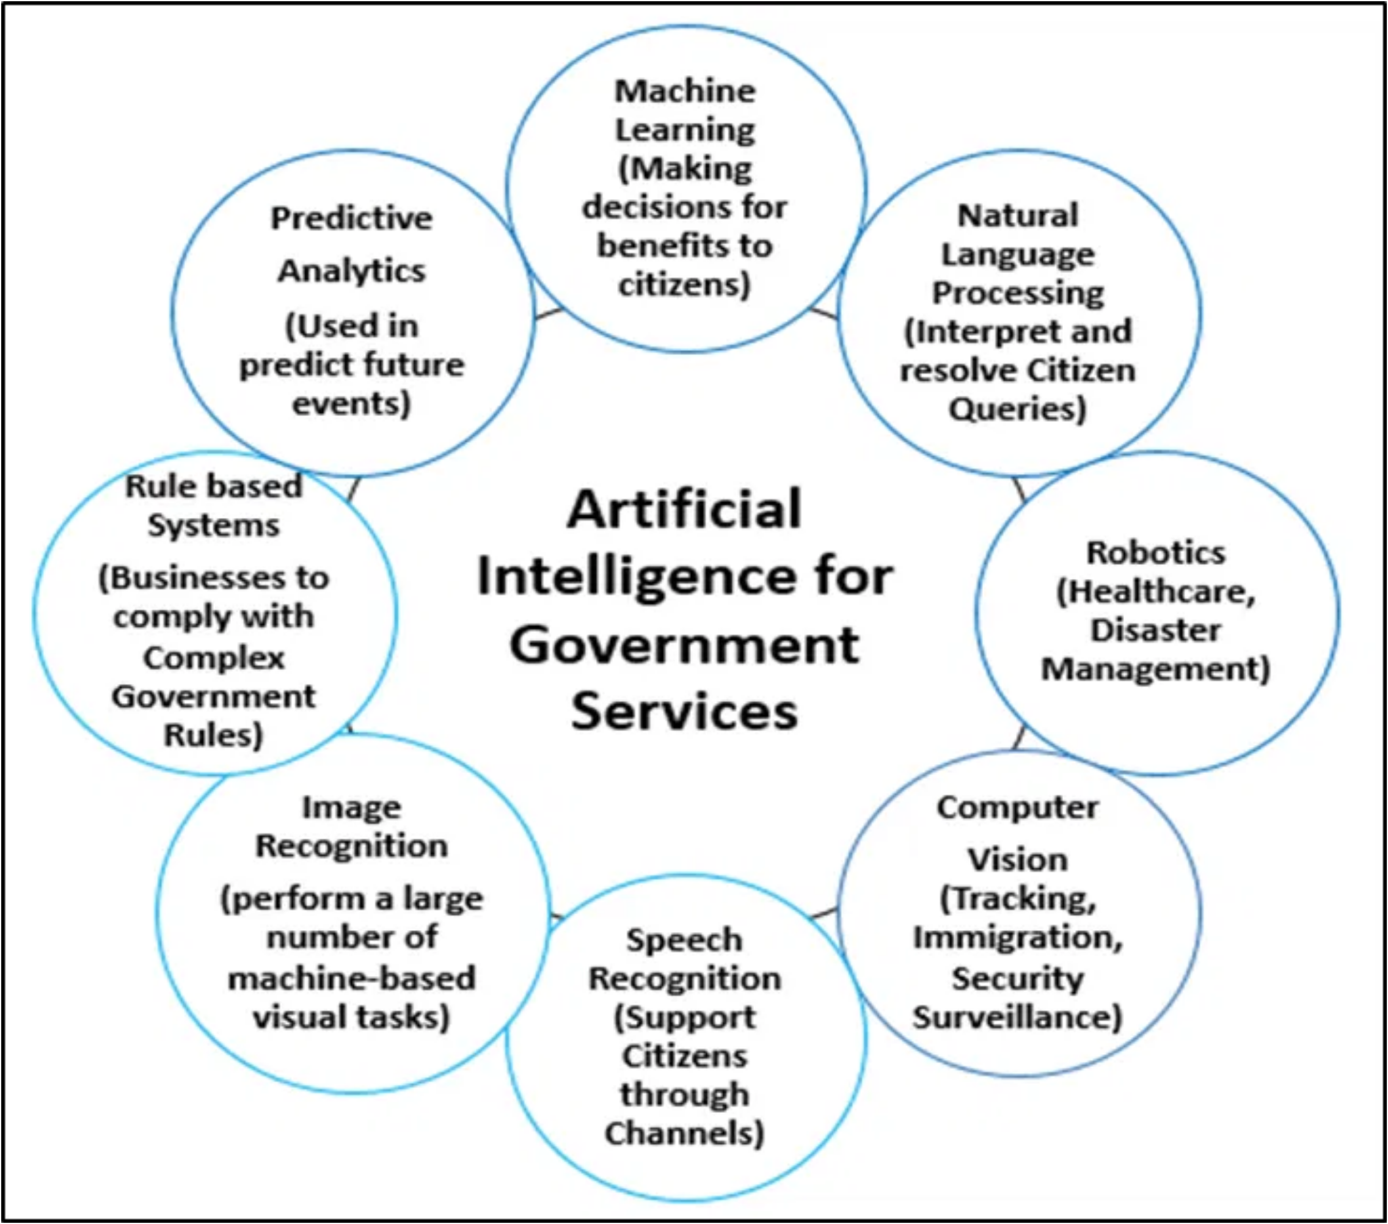
Agentic AI: Your Digital Government Employee
AI that takes actions, not just provides advice
Key Capabilities:
Decision-Making:
Within defined parameters
Multi-System Integration:
Works across platforms
Autonomous Execution:
Completes full workflows
Traditional AI
Agentic AI
Provides instructions
Takes actions
Requires human execution
Autonomous execution
Knowledge-focused
Outcome-focused
Notes:
"Think of Agentic AI like hiring an incredibly capable new employee, except this employee never sleeps, never takes vacation, and can work in fifty different software systems simultaneously. When you delegate a task to your human colleague, you give them the goal and trust them to figure out the steps. Agentic AI works the same way, but with digital superpowers.
Here's how it actually works. Instead of asking 'How do I process this permit application?' you tell the AI agent: 'Process this restaurant permit application for 1425 Biscayne Boulevard.' The agent doesn't just give you instructions—it logs into the zoning database, verifies compliance, schedules the required inspections, notifies relevant departments, and updates the applicant on status.
The crucial difference is agency—the AI can make decisions within defined parameters and take actions without asking permission for every step. Just like when you tell a human staff member to 'handle the Johnson complaint,' you're not micromanaging every phone call they make. You're trusting their judgment within established guidelines."

Slide 5
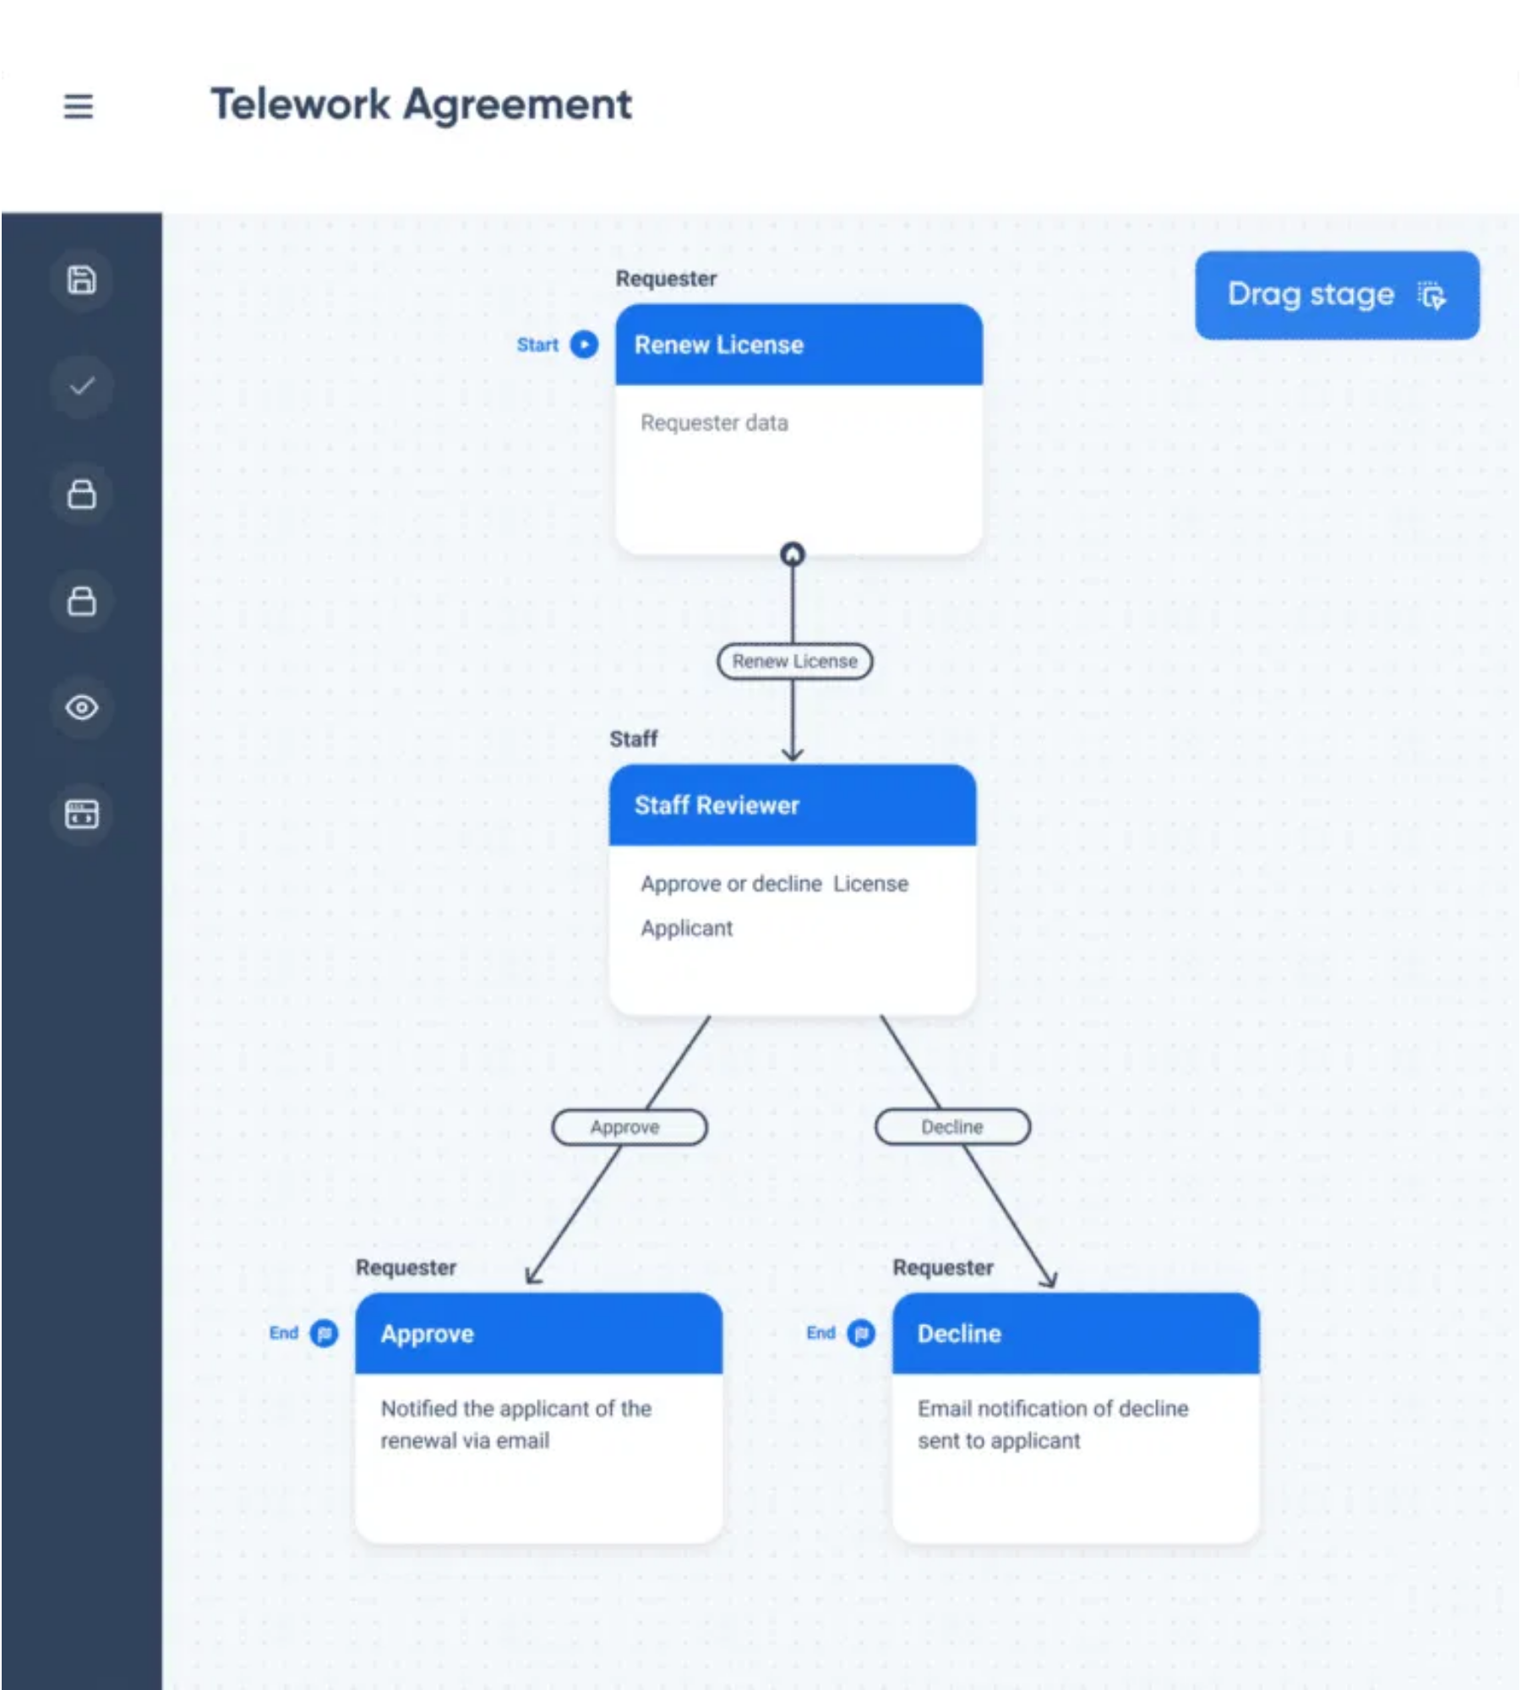
From Request to Resolution: Automated Workflows
Agentic AI bridges the execution gap by taking action across systems
Process Flow:
1
Citizen Request
: Application submitted
2
AI Analysis
: Requirements verified
3
Multi-System Execution
: Coordinated processing
4
Completion
: Approval and notification
Example: Food Truck License
Process completed in minutes vs. weeks through automated zoning verification, health department scheduling, and inter-departmental notifications
Notes:
"Let me show you exactly how this works with a real example. A food truck owner submits a license application through the county portal. An AI agent immediately validates all required documents, cross-references the proposed location against zoning regulations, schedules health department inspection based on inspector availability, generates the required inter-departmental notifications, and sends the applicant a confirmation with timeline expectations—all within minutes of submission.
But here's where it gets really powerful. While one AI agent handles that food truck license, others are simultaneously processing permit renewals, responding to routine citizen inquiries, updating case files, and coordinating between departments. Each agent specializes in specific workflows but can communicate with others when coordination is needed."

Slide 6

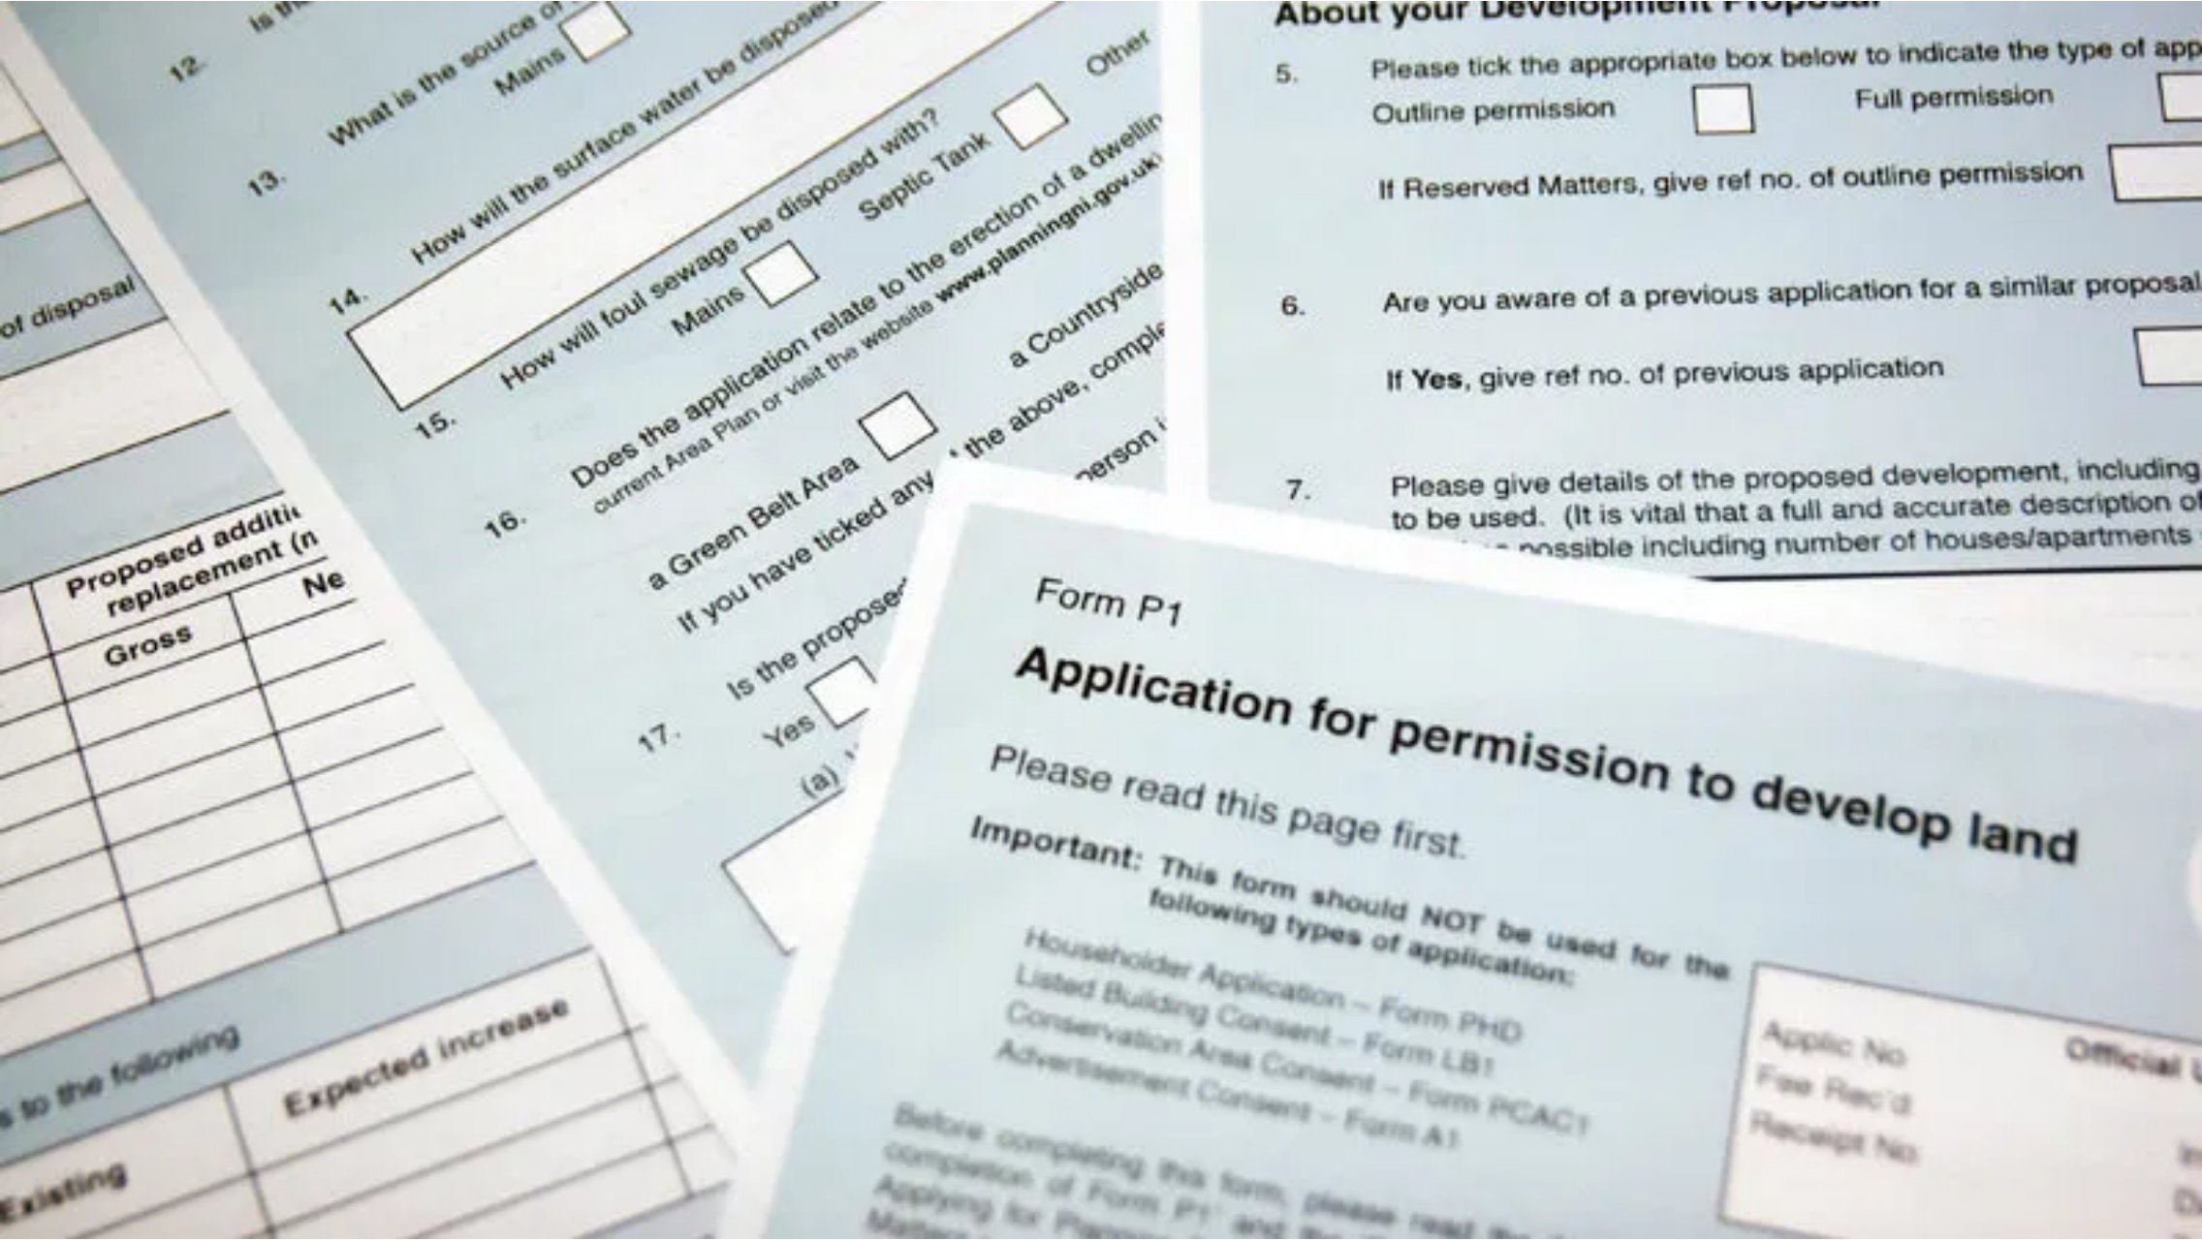




Transforming County Services Through AI Agents
Miami Dade-specific applications with immediate impact
Key Use Cases:
Building Permits
Automated hurricane code verification and compliance checks
Business Licenses
Streamlined application processing and inspection scheduling
Citizen Complaints
End-to-end resolution tracking and department coordination
Emergency Response
Cross-agency coordination during hurricanes and emergencies
Notes:
"The impact on government efficiency is staggering. Processes that typically take weeks can happen in days or hours. Citizens get faster responses. Staff spend time on complex cases requiring human judgment rather than routine administrative tasks. And because AI agents work consistently, there's less variation in service quality between different offices or staff members.
For Miami Dade specifically, imagine AI agents that can process building permits by automatically checking hurricane codes, verify business licenses against local regulations, coordinate emergency response across multiple agencies, and even help citizens navigate complex county services through natural conversation—not just providing information, but actually starting processes on their behalf."

Slide 7

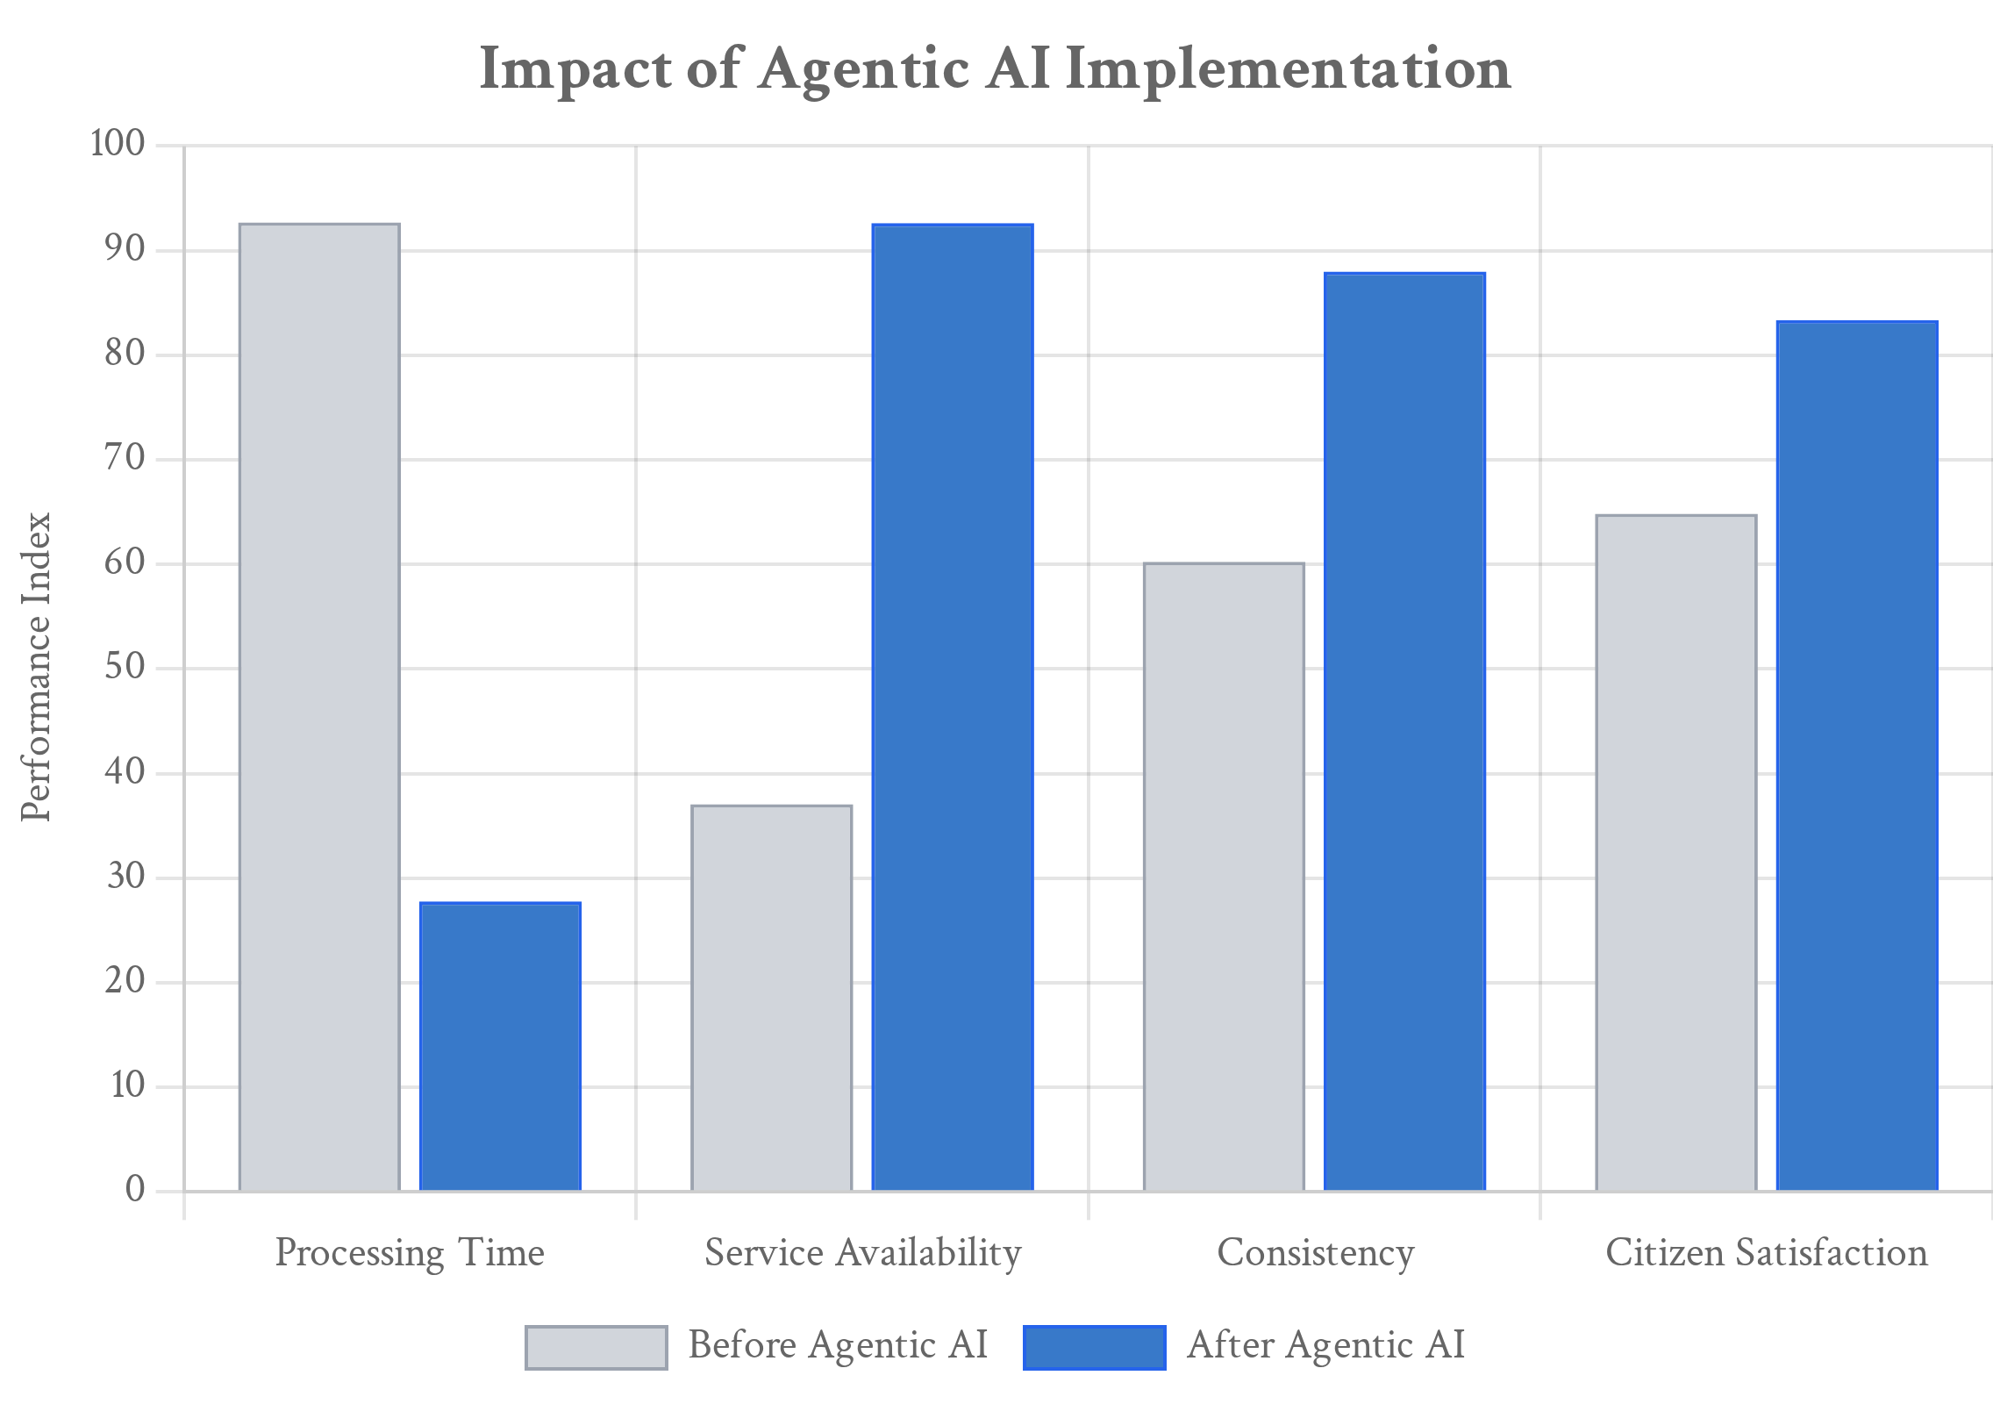
Measurable Impact on Government Operations
Quantifiable improvements in efficiency, consistency, and service
Key Benefits:
Processing Speed:
70% faster application processing
Availability:
24/7 service without staffing constraints
Consistency:
95% uniform application of regulations
Staff Focus:
Redirection to complex cases requiring
judgment
Citizen Experience:
Faster responses, reduced wait times, and consistent service quality regardless of office location
*Based on early adopter government agencies implementing Agentic AI
Notes:
"The impact on government efficiency is staggering. Processes that typically take weeks can happen in days or hours. Citizens get faster responses. Staff spend time on complex cases requiring human judgment rather than routine administrative tasks. And because AI agents work consistently, there's less variation in service quality between different offices or staff members."

Slide 8

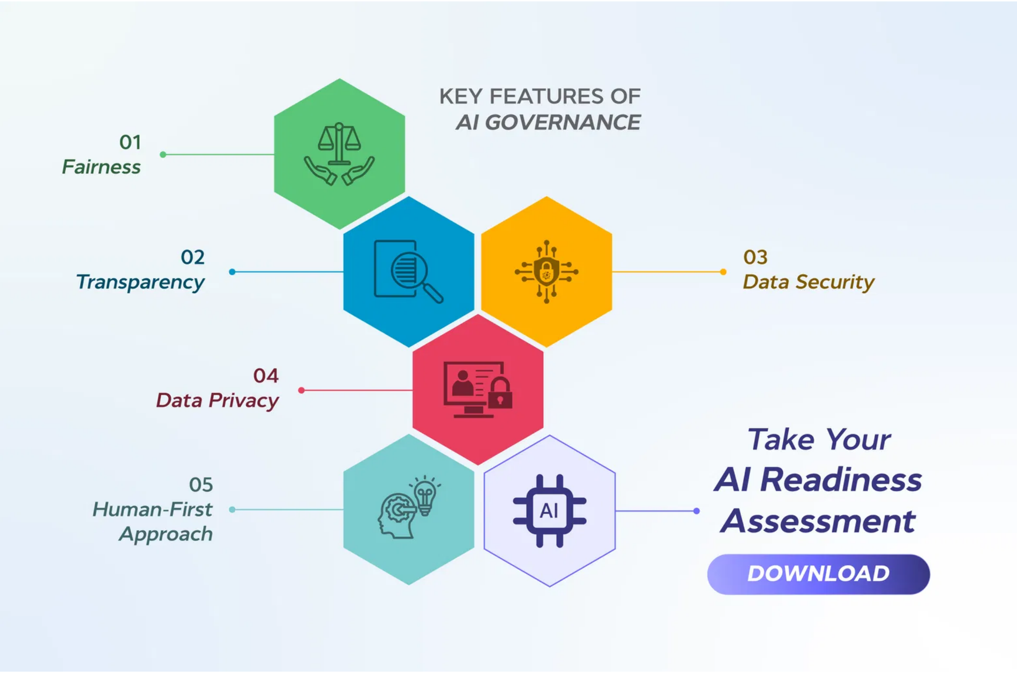



Ensuring Accountability in AI-Driven Government
Responsible AI implementation requires robust governance
Security Protocols
Access controls with least-privilege principles
Comprehensive audit trails for all actions
Encrypted data transmission and storage
Human Oversight
Clear decision boundaries for AI agents
Exception handling with human escalation
Regular review of automated decisions
Compliance
Alignment with regulatory requirements
Transparency in automated processes
Regular third-party audits
Notes:
"Now, you might be thinking this sounds too good to be true, and you'd be right to have concerns. Giving AI the ability to take actions rather than just provide information introduces serious responsibilities around accountability, security, and oversight that we've never faced before.
The critical question becomes: how do you ensure AI agents make appropriate decisions when they encounter situations outside their training? Unlike human employees who can use judgment and ask for guidance, AI agents need explicit boundaries and escalation procedures built into their design.
Every action an AI agent takes must be logged and auditable. When a human processes a permit, there's inherent accountability because we know who made which decisions. With AI agents, we need technological systems that provide the same level of oversight and responsibility tracking.
Security becomes paramount when AI has the ability to access and modify government databases, send official communications, and make decisions that affect citizens' lives. These agents need sophisticated permission systems that limit their access to only what's necessary for their specific functions."

Slide 9
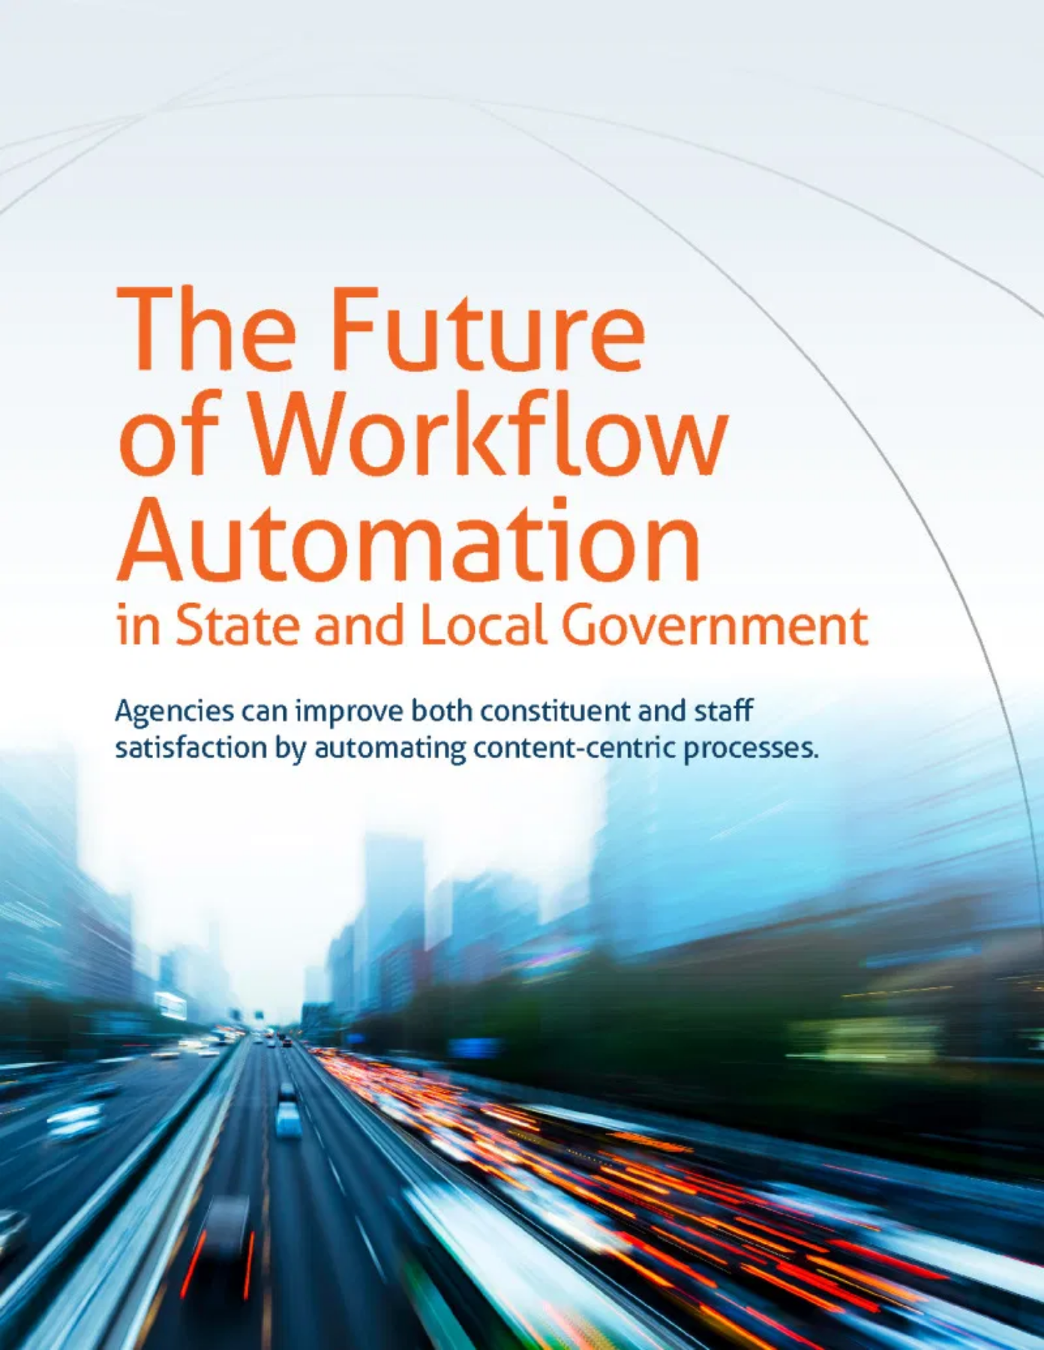
Strategic Approach to Agentic AI Deployment
Phased implementation ensures controlled adoption
1
Pilot Programs
Building permit processing automation
Limited scope with high oversight
2
Expansion
Citizen-facing services integration
Additional department onboarding
3
Integration
Cross-department workflows
Advanced use cases deployment
Months 1-6
Months 7-12
Months 13-18
Notes:
"Understanding Agentic AI reveals something profound about the future of public service. For centuries, government efficiency was limited by human bandwidth—how many cases one person could handle, how quickly they could coordinate between departments, how consistently they could apply complex regulations.
Agentic AI doesn't replace human judgment—it amplifies human capacity. It handles the routine so humans can focus on the complex. It provides 24/7 service so citizens don't wait for business hours. It ensures consistent application of rules so service quality doesn't depend on which office you visit or which staff member helps you."

Slide 10

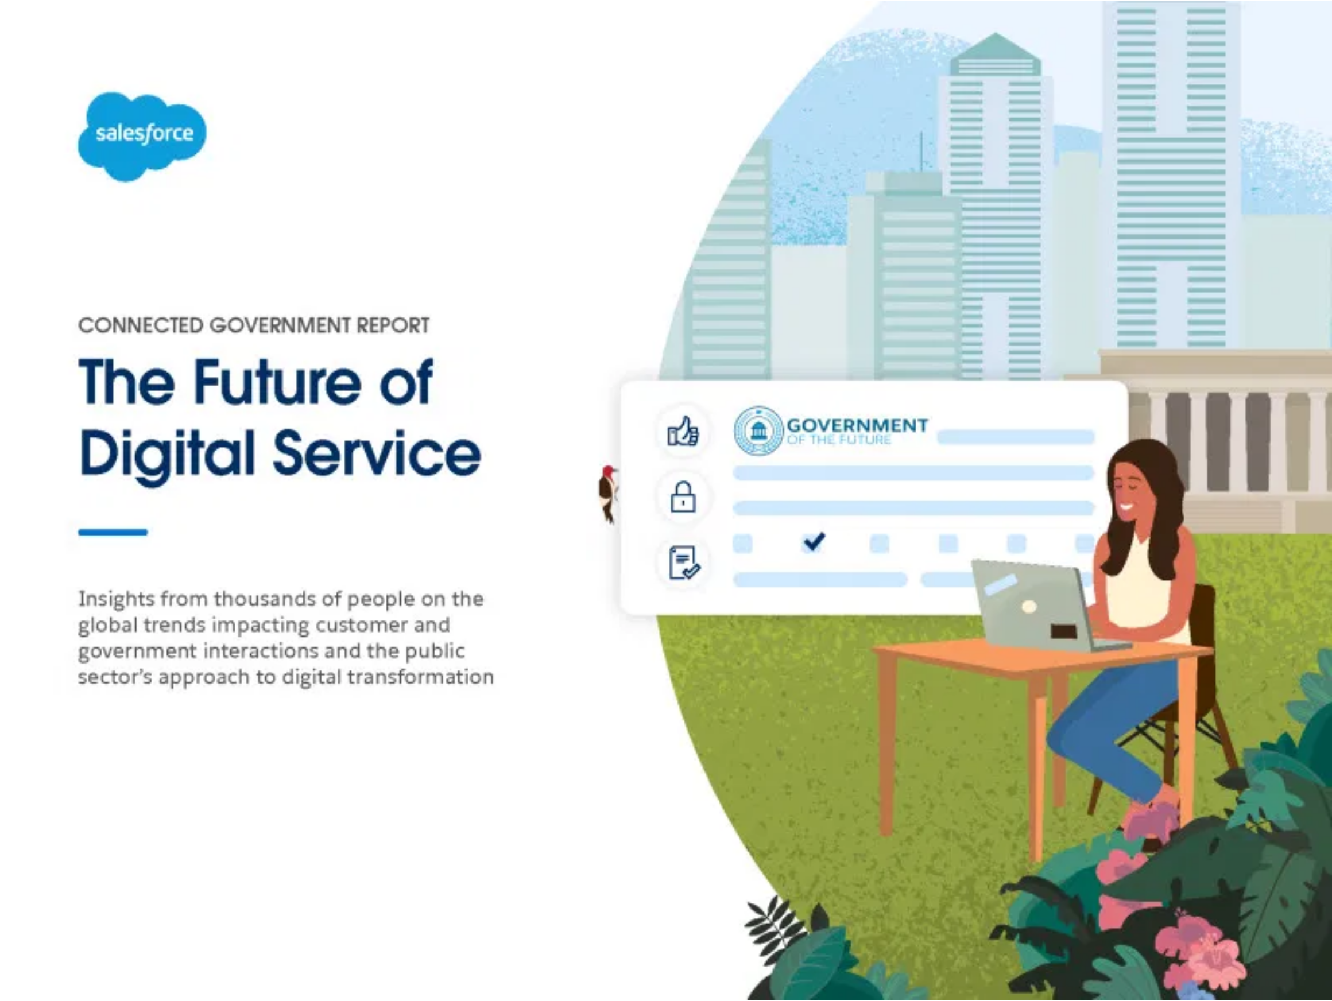



Building the Future of Public Service
Agentic AI transforms government from reactive to proactive
Our Vision:
More Responsive:
Immediate service delivery
More Efficient:
Optimized resource allocation
More Accessible:
24/7 service availability
Next Steps:
Pilot program approval
Stakeholder alignment workshop
Implementation timeline development
Dr. Ernesto Lee
Miami Dade College
elee@mdc.edu |
Notes:
"When implemented thoughtfully, Agentic AI could make Miami Dade County government more responsive, more efficient, and more accessible to the citizens who depend on your services. That's not just technological progress—that's fulfilling the fundamental promise of public service.
That's something worth building, my friends."

